Slide 1
Military Institute of Science & Technology (MIST)
Department of Computer Science & Engineering (CSE)
Solution of Simultaneous
Linear Equations
CSE 214
Numerical Methods Sessional
Credit Hr. 1.50, Contact Hr. 3.00
Lec Tarannum Zaki
Dept. of CSE
MIST

Slide 2
OUTLINE
Solution of simultaneous linear equations:
Gauss-Seidel (Iterative) Method

Slide 3
INTRODUCTION
Simultaneous Linear Equations: Solution Methods
Direct Method:
1) Naïve Gauss Elimination Method
2) Gauss-Jordan Elimination Method
Indirect Method (iterative method):
1) Gauss-Seidel Elimination Method

Slide 4
INTRODUCTION
Gauss-Seidel Elimination Method
Gauss-Seidel Elimination method consists of two phases:
Algebraically solve each linear equation for x_{i}
Assume an initial guess solution array
Solve for each x_{i} and repeat
Use absolute relative approximate error after each iteration to check if error is within a pre-specified tolerance.

Slide 5
INTRODUCTION
Gauss-Seidel Elimination Method
Terminating Condition:
1. Use absolute relative approximate error after each iteration to check if error is within a pre-specified tolerance.
For example, terminate when the absolute relative approximate error for all the unknowns is less than 50%.
2. Repeat iteration until a pre-specified number of significant digits after decimal point is achieved.
For example, terminate when correcting up to 5 decimal points.
3. Repeat iteration until a pre-specified number of iteration is achieved.
For example, terminate when 5 iterations are completed.
NOTE: If nothing is specified, then terminate when repetitive value is being achieved for each unknown.

Slide 6
INTRODUCTION
Gauss-Seidel Elimination Method
Now, to find x_{i}’s, one assumes an initial guess for the x_{i}’s (Simple way is to assume 0 as initial guess) and then uses the rewritten equations to calculate the new estimates.
Remember, one always uses the most recent estimates to calculate the next estimates, x_{i}
If the diagonal elements are non-zero, each equation is rewritten for the corresponding unknown:

Slide 7
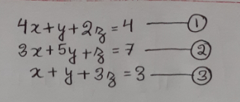
INTRODUCTION
Gauss-Seidel Elimination Method: Example
Find the value of the unknowns x, y and z from the following set of equations:

Slide 8
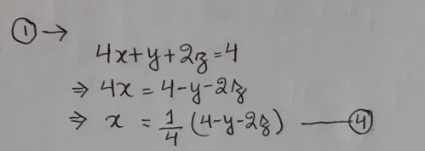
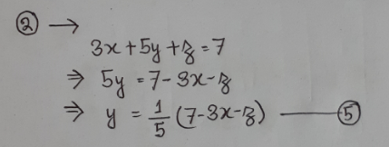
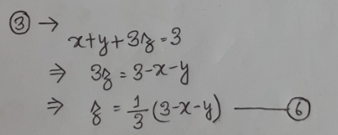

Slide 9
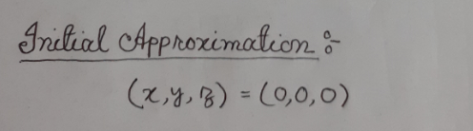
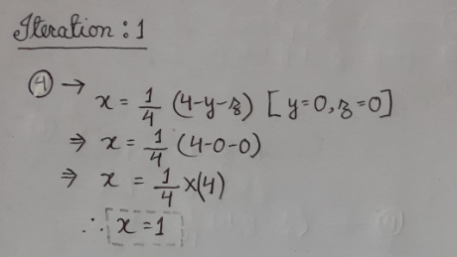
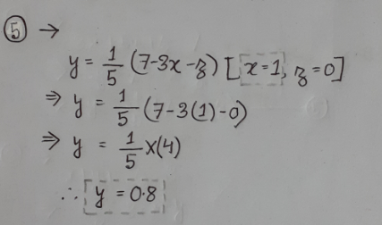
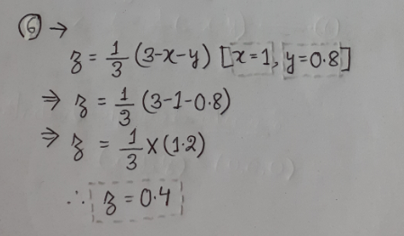

Slide 10
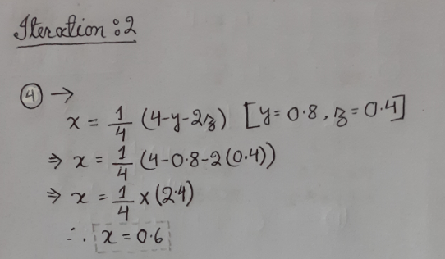
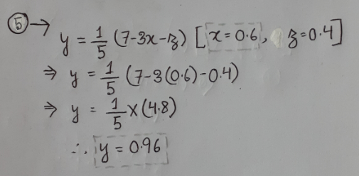
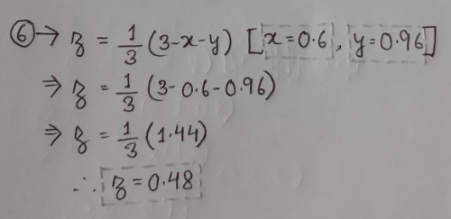

Slide 11
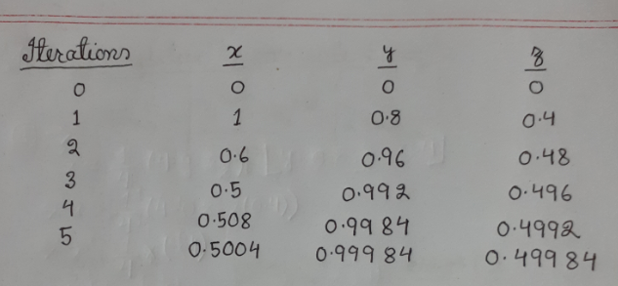
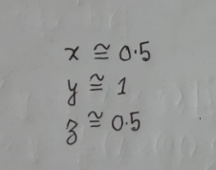

Slide 12
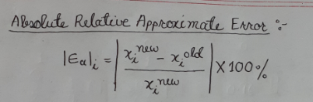
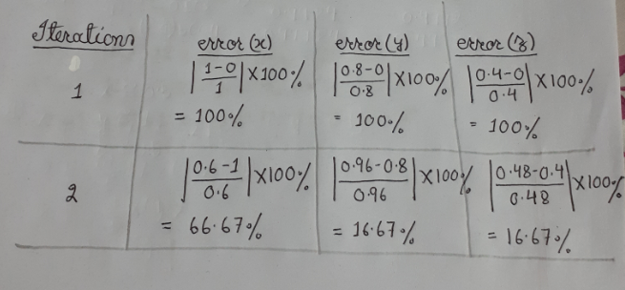

Slide 13
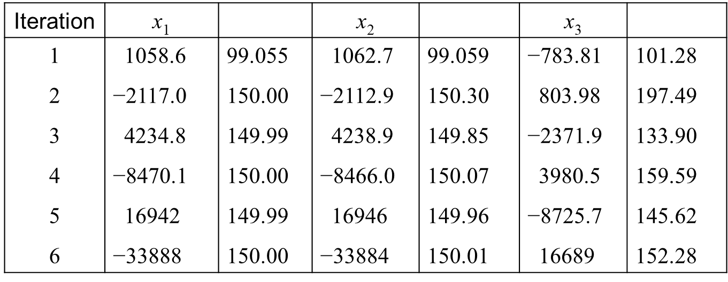
INTRODUCTION
Gauss-Seidel Elimination Method: Absolute Relative Approximate Error
NOTE: The absolute relative approximate errors are not decreasing.

Slide 14
INTRODUCTION
Gauss-Seidel Elimination Method: Pitfalls
What went wrong?
Even though done correctly, the answer is not converging to the correct answer.
This example illustrates a pitfall of the Gauss-Seidel method: not all systems of equations will converge.

Slide 15
INTRODUCTION
Gauss-Seidel Elimination Method: Solution to the Pitfalls
One class of system of equations always converges: One with a diagonally dominant coefficient matrix.
For every row: the element on the diagonal needs to be equal than or greater than the sum of the other elements of the coefficient matrix
Checking if the coefficient matrix is diagonally dominant
The inequalities are all true and at least one row is strictly greater than:
Therefore: The solution should converge using the Gauss-Seidel Method

Slide 16
INTRODUCTION
Gauss-Seidel Elimination Method: Solution to the Pitfalls
What can be done? If the coefficient matrix is not originally diagonally dominant, the rows can be rearranged to make it diagonally dominant.
The coefficient matrix is not diagonally dominant
But this is the same set of equations which converges

Slide 17
THANK YOU

